Slide 1
Student Career Path App
Helping Students Choose and Achieve Their Career Goals

Slide 2
Introduction
Our team aims to develop an app designed to help students discover and pursue their ideal career paths from an early age. It will provide personalized guidance, helping students explore careers, set goals, and access the resources needed to achieve them. The app leverages NPC labor force datasets to measure salary expectations and job demand for each career, ensuring students make informed decisions about their future.

Slide 3
The Problem we are trying to solve:
Many students struggle to decide their career paths until a later stage in their education which often delays their progress or prevents them from achieving their goals. Our survey revealed that most students make career decisions during high school or university, missing the opportunity to prepare earlier and build productive habits early on.

Slide 4
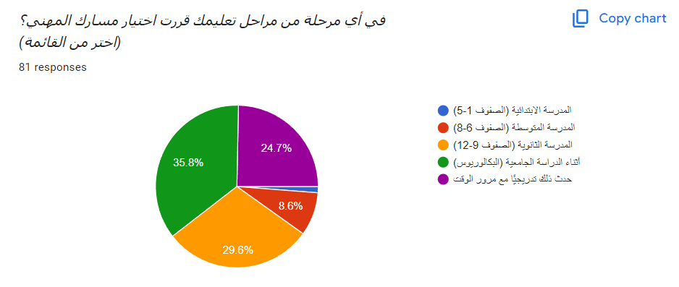
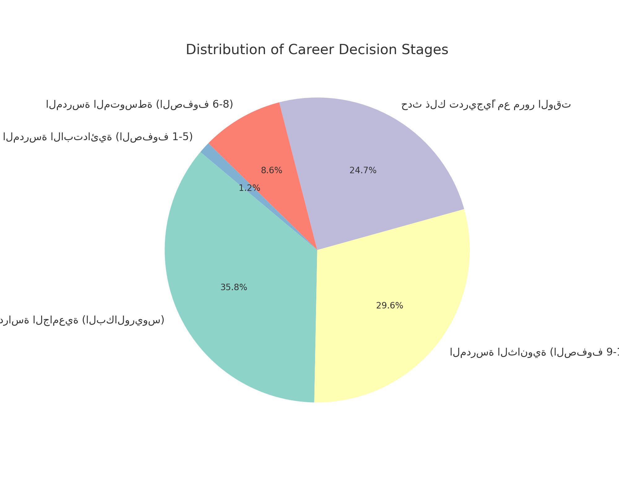
Survey Results

Slide 5
Proposed Solution
We propose an app that guides students in identifying their career interests early. The app provides:
an AI model which interacts with the NPC labor force dataset to make it accurate.
gamified career path system.
Progress tracking.
Resources to build necessary skills.

Slide 6
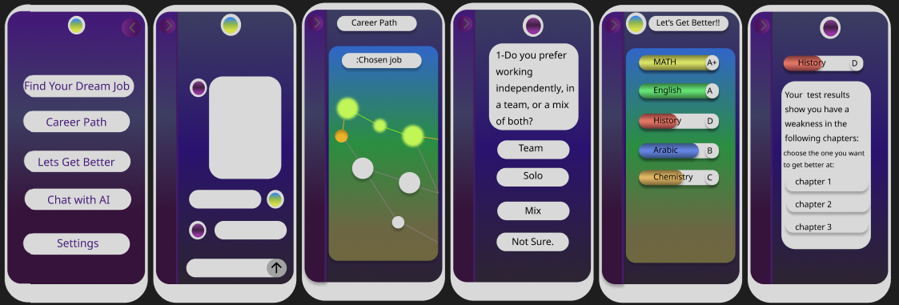
App Design

Slide 7
Impact
Explore career paths aligned with their skills.
02
Start preparing for their future careers early.
03
Make informed educational and career decisions
04
Our app will encourage students to build productive habits and set clear goals.
01
Boost productivity across all work sectors at a notable rate
05

Slide 8
Conclusion and Next Steps
Next steps include:
- Finalizing app development.
- Conducting user testing.
- Partnering with schools for early adoption.
- Enhancing features based on user feedback.

